Slide 1
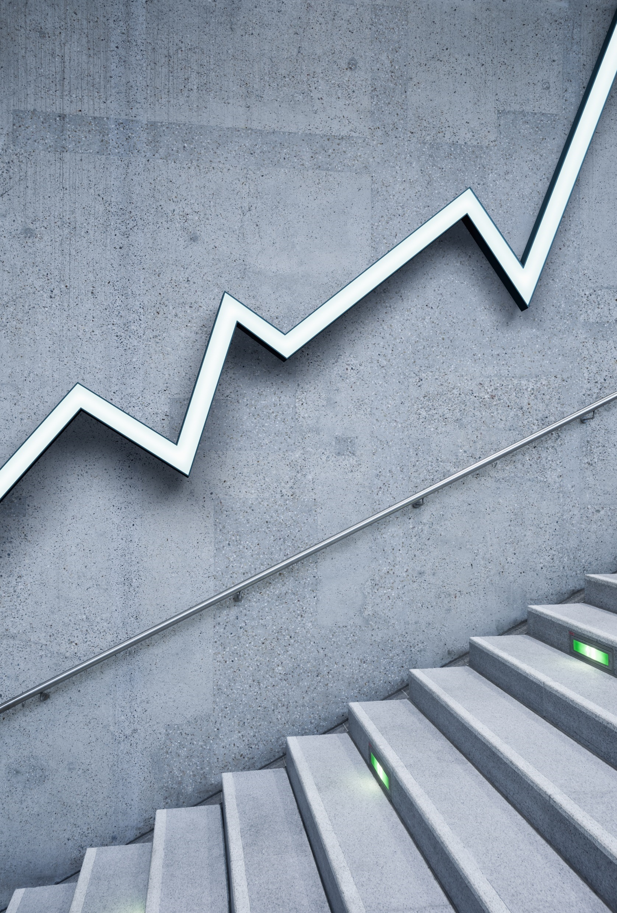
Bias Audit
Cyberspace

Slide 2
Introduction
This project conducts a bias audit on the widely used Adult Income Dataset from the UCI Machine Learning Repository. The dataset is often used to predict whether an individual earns more than 50K per year based on attributes like age, education, occupation, race, and gender.
The goal of this audit is to:
Identify potential biases in income predictions, particularly across gender and racial groups.
Quantify fairness metrics such as statistical parity and disparate impact.
Apply mitigation techniques like Reweighing and Disparate Impact Remover to reduce unfairness.
Evaluate trade-offs between fairness and model accuracy.

Slide 3
Key bias patterns & Mitigation strategies implemented
Key bias
Mitigation Strategies
Gender Bias:
Males earning >50K: 30.6%
Females earning >50K: 10.9%
Statistical Parity Difference: -0.199
Disparate Impact: 0.35 (well below the fairness threshold of 0.8)
Racial Bias:
Whites earning >$50K: 25.6%
Blacks earning >$50K: 12.4%
Statistical Parity Difference: -0.131
Disparate Impact: 0.48
Reweighing (Gender Bias):
Adjusted instance weights to balance outcomes
Accuracy improved to 95.9%
Fairness improved: Average Odds Difference reduced to -0.015
Disparate Impact Remover (Race Bias):
Repaired features to reduce racial bias
Accuracy: 86.9%
Fairness improved: Disparate Impact to 0.32

Slide 4
Fairness Metrics Comparison
Model | Accuracy | Statistical Parity Difference | Disparate Impact | Average odds difference
Baseline | 85.8% | -0.173 | 0.338 | -0.066
Reweighting | 95.9% | -0.186 | 0.358 | -0.015
DI Remover | 86.9% | -0.173 | 0.322 | -0.047

Slide 5
Real-world implications
Unfair income predictions can reinforce systemic inequalities.
Hiring, lending, and insurance decisions based on biased models can lead to legal and ethical issues.
Transparency and fairness are essential for public trust in AI systems.
Credit Scoring income prediction can influence loan approvals.
Social Equity biased AI can reinforce systemic inequalities.

Slide 6
Recommendations for stakeholders
Refine Feature Engineering: Remove or transform sensitive attributes (e.g., race, gender) using fairness-aware techniques like Disparate Impact Remover.
Use Reweighing During Training: Apply Reweighing to balance the influence of privileged and unprivileged groups, improving fairness without sacrificing accuracy.
Monitor Fairness Metrics Continuously: Track Statistical Parity Difference, Disparate Impact, and Average Odds Difference during model development and deployment.
Incorporate Fairness into Model Selection: Choose models not just based on accuracy, but also on fairness performance across demographic groups.

Slide 7
Conclusion
The audit revealed significant bias in income predictions across gender and race.
Fairness metrics like Statistical Parity Difference and Disparate Impact confirmed these disparities.
Applying Reweighing and Disparate Impact Remover improved fairness while maintaining strong model performance.
This project highlights the importance of auditing and mitigating bias in machine learning models.
Ensuring fairness is not just a technical challenge—it's a social responsibility.

